Slide 1
Software Processes
Software Engineering
Neil Toporski

Slide 2
1. The Software Process [Outline]
The 4 fundamental activities of the software process
The System Development Life Cycle (SDLC)
Planning
Analysis
Design
Development
Integration and Testing
Implementation
Maintenance
Choosing a process

Slide 3


1.2 The Software Process
A software process is a set of related activities that leads to the development and completion of a software system.
“Do Something” is a software process that includes 4 fundamental activities:
Specification: What the system does. How does it function?
Design and Development: What is the architecture and organization of the system? How is it implemented?
Validation: Does it perform according to the client specifications?
Evolution: How the system can change in response to changing client needs.
Idea → Do Something → Product Deliverable
Notes:
Where to start and how to end?

Slide 4
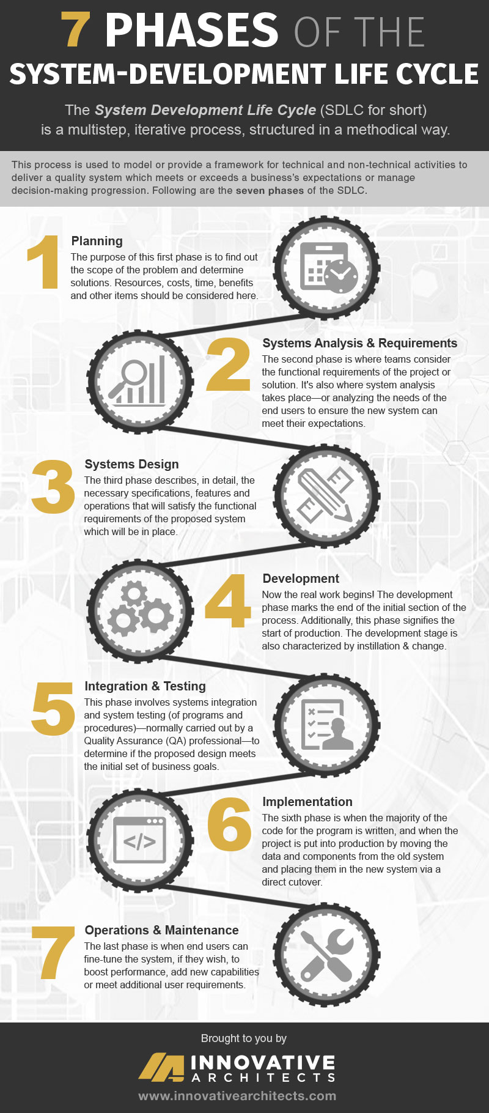
System Development Life Cycle (SDLC)
7 Phases
The system-development life cycle enables users to transform a newly-developed project into an operational one.
The SDLC is a multistep, iterative process, structured in a methodical way.
This process is used to model or provide a framework for technical and non-technical activities to deliver a quality system which meets or exceeds business expectations or manage decision-making progression.

Slide 5
Planning

Slide 6
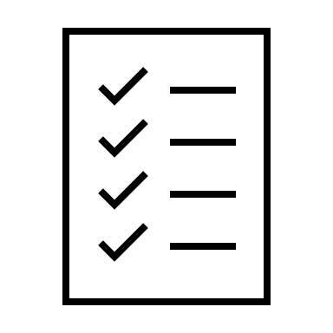
Planning
Starts with an idea → Ends with organizational approval.
Three primary planning activities:
What is the scope of the project?
Define the system to be developed. What system best supports your strategic goals? What are the critical success factors (CSF) for success?
Set the scope of the project. Define in a few sentences the high-level system requirements.
Define a high-level plan. What are the milestones and key dates where specific group of activities need to be performed?

Slide 7
Planning: Project Initiation Document (PID)
What the project is aiming and planning to achieve.
Why is it important to meet these aims?
May contain all or most of the following
Project Scope Statement
Project Background (history)
Feasibility Analysis
Initial Project Plan
(milestones, dates)
Risk Assessment
Assumptions, Dependencies and Constraints
Organization and Governance (team org chart)
Communication Plan (meetings, minutes)
Quality Plan (list of deliverables)
Estimated Costs and ROI
Notes:
Project scope – things can change, need to assess again
Feasibility analysis – is this possible?
Milestones, dates – semester
Risk assessment – constraints (ex. Learning curve)
Organization and governance – deciding roles
Communication plan – scrum
Don’t need 10

Slide 8
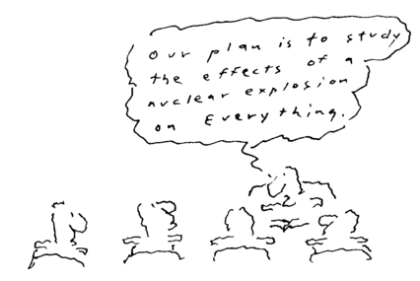
Planning: Feasibility and “Doability”

Slide 9
Project Scope: Example
A sample business requirement might look like
“The system must track all the employees by their respective department, region, and the designation.”
This requirement is ambiguous – it shows no such detail as to how the system will implement this requirement, but rather what the system must do concerning the business.
Notes:
Which employees? Which regions? How to track them? Is it online or at each business location?
How do they want to implement this?

Slide 10
Project Scope: Example : Eventcia (2005)
Eventcia is a Web-based service that allows two or more people to meet in real-time to (1) communicate using VoIP (Voice over IP), video, and text chat, (2) collaborate using a whiteboard with full-featured drawing and annotation tools, PowerPoint presentations, digital images, and polling tools, and (3) share documents and view computer desktop applications.
Eventcia allows groups to get together, virtually, to meet, present, train, teach, sell, brainstorm, or share information in real-time, anytime and anywhere with an Internet connection, computer, headset, or Web cam. Eventcia offers an easy-to-use interface with a host of interactive features accessible on any platform, using any operating system and most Web browsers.
Our vision is clear: collaboration not bounded by any Web browser, operating system, platform, or device, thus expanding Eventcia into markets that include mobile environments, such as PDA’s and cell phones, and diffuse the adoption of Eventcia through accommodating the needs of the consumer.
Notes:
Lists tasks it accomplishes with numbers
What does the project allow for it to happen?
What does the future look like? What is hoped to be accomplished? (users?)
Good understanding on where you want project to go

Slide 11
Planning: What’s a Good PID?
As the IT Approver
Is this project feasible? Does the client understand enough about technology?
Did the client adequately define the resources required?
Does the client understand the potential risks?
Do I understand the business value of the project?
What is the approach or methodology to be used?
As a Business Approver
Is the project description complete and cover key aspects?
Are my high-level requirements well defined and stated?
Is the scope correct?
As a Consumer/User of this Document
What is the purpose of the project?
Why is this project important? (as a consumer)
How will communications occur?
Notes:
Business value – what does the customer want
Methodology - scrum

Slide 12
Analysis

Slide 13
Analysis
Starts with end users and developers working collaboratively to gather, understand, and document the business requirements for the proposed system.
Business requirements are the detailed set of knowledge that the system must meet to be successful.
Define and prioritize business and user requirements
Which methodology is best for this project?
*Document standards may vary with methodology and the institution.
Notes:
Functional vs nonfunctional requirements

Slide 14
Design and Development

Slide 15
Design and Development
The primary goal of the design phase is to build a technical blueprint of how the proposed system will work. How do you transform the business idea to the technical perspective?
The technical architecture defines the hardware, software, and required networking configurations for a successful system.
Defines and specifies the interfaces, parameters, and protocols used by the product architecture and system architecture layers.
The design document could be 1) specifications for development or 2) the outcome of development (or both).

Slide 16
Design Document: Outline
The System Design Document describes the system requirements, operating environment, system and subsystem architecture, files and database design, input formats, output layouts, human-machine interfaces, detailed design, processing logic, and external interfaces.
Introduction
Purpose and scope
Project summary
System overview
Design constraints
Future contingencies
Document organization
Points of contact
Project References
Glossary
System Architecture
Hardware
Software
Communication Architecture
File and DB design
Interface
Inputs, outputs
Detailed design
Hardware
External interface
System integrity controls

Slide 17

Integration and Testing

Slide 18
Alan Mulally
Former CEO Boeing
Former CEO Ford Motor Company 2006-2014
Ford senior executive to Mulally: “We appreciate you coming here from a company like Boeing, but you’ve got to realize that this is a very, very capital-intensive business. (noting Alan Mulally knew nothing about the automobile industry)
Alan Mulally’s retort: “That’s really interesting. The typical passenger jet has four million parts…and it has to fly.”

Slide 19
Alan Mulally
How Alan Mulally used Scrum
Removed “Silos” (functional teams)
Business meetings included not only VPs but staff/workers
Required Engineers to work with Designers
Required Designers to work with Clients
Changed the industry culture
Understood his product
Workers also received “bonuses”
Reduced bureaucracy
Globalized production
”Quality first”

Slide 20
Integration and Testing
The testing phase of the SDLC verifies that the system works and meets all requirements defined in the analysis phase.
First, you develop detailed test conditions, which are the detailed steps the system must perform along with the expected results of each step.
Second, you perform the test.
Types of testing
Ad hoc: normal testing performed by the developer during coding process.
Unit: test only a single unit (“snippit”) of code to see if it functions as expected in isolation.
Integration: individual units are tested as a group.
System: test the system as a whole.
Notes:
Don’t forget to comment

Slide 21
Testing
Except for small programs, systems should be follow a 3 step testing protocol
Component testing: Each component is tested individually by the team members developing that component.
System testing: This process is concerned with finding errors that result from unanticipated interactions between components and interface problems.
Customer (user) testing: The system is tested by the system customer or potential user. This may find unexpected user interaction anomalies.

Slide 22
Implementation

Slide 23
Implementation
Development -> Testing -> Production Environment
During the implementation phase you distribute the system to all the knowledge workers so they can begin using the system to perform their everyday jobs.
Typical Activities
Create implementation plan.
Deploy system to a staging environment.
Provide user documentation. (how the system works)
Prepare system support teams.
Train knowledge workers.
Notes:
User doc – one of the last documents written

Slide 24
Implementation Techniques: Rowan Printing
Parallel implementation: using both old and new systems until new system functional.
Plunge implementation: discard old system completely and start new system.
Plot implementation: having only a small group of people (focus groups) use the new system until you know it works correctly.
Phased implementation: implementing the new system on part at a time.

Slide 25
Maintenance

Slide 26
Maintenance
Begins when the system is put into production.
Monitor and support the new system to ensure it meets the business goals.
Change the system as the business changes
Minor changes and bug fixes can be processed through change management processes which also go through their own SDLC.
Major enhancements often require a new Project Initiation Document (PID) and, if approved, spawn their own SDLC.

Slide 27
1.3 Choose a Process: Plan Driven or Agile?
Plan Driven: Waterfall Model
All process activities are planned in advance.
Progress of the system is measured against this plan
Incremental Development: Scrum
The system is developed as a series of versions with each version adding incremental functionality to the previous version.
Each incremental step produces a potentially shippable product.

